Slide 1

Inspection Module Functions powered by AI

Slide 2

Datatera System Architecture
Datatera Marketplace
Datatera Inspect
Dataset
Algorithm
Pay & Onboard algorithm
Onboard dataset
Datatera
Inspector
Functions
Data Provider
Datatera
C2D flow
Data Consumer
Get compute result
Get paid
Blockchain Network
Search dataset
metadata

Slide 3

Datatera Inspector KPI for Data Quality
Accuracy - The ratio of data errors
Completeness - The number of missing values
Consistency - The number of inconsistencies
Uniqueness - The number of duplicates
Timeliness - The number of records with delayed changes
Data Quality Ratio

Slide 4

Datatera Inspector Data Sensitivity Analysis
Id/Passport Number
Name & Surname
Home/Post Address
Phone Number
Credit Card Number
Id | Name | Address | Treatment
1 | Anna | Stockholm | Med123
Id | MedName | Treatment | PatId
1 | Vac12 | CompX | 12345

Slide 5
Datatera Inspector for Dataset
Dataset
Datatera Inspector
Sensitive Data Analysis
Create Analysis Table
DatasetId | DtName | DtOwner | DtSensitive
1 | Vac12 | CompX | True
Azure Table Storage
KpiId | KpiName | KpiDesc
1 | IdNum | Identify
DtId | KpiId
1 | 1

Slide 6


Metadata Features
The quality data in ratio based on the KPI
Data points and metric of the training data
Highly sensitive data that will not provide any value will not be included in the computing
Dummy data download if the provider allows

Slide 7
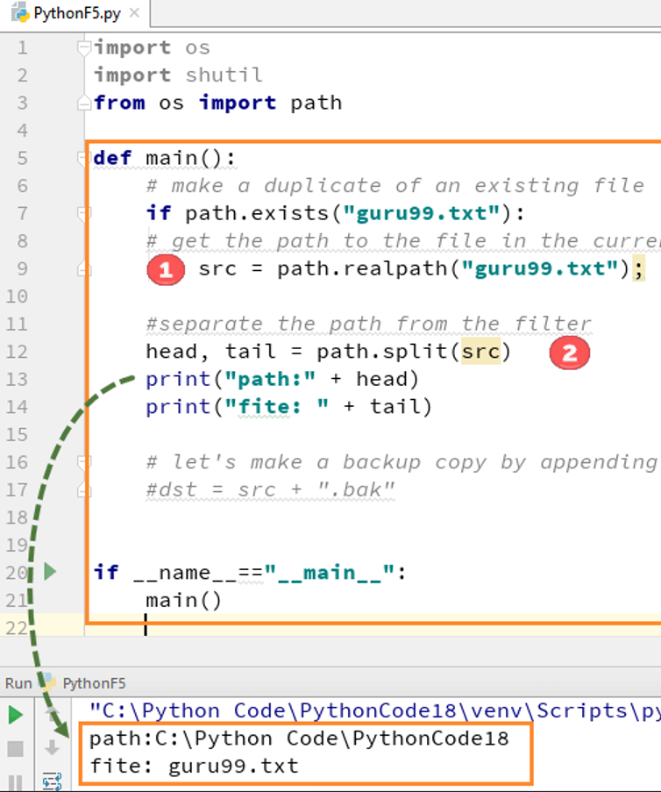
Datatera Inspector Metrics for Algorithm Scan
Copy/Print Data
Save/Write Data into a file
Modify/Corrupt Data
Transferring Data to external sources
Allowing other instances get access to Data

Slide 8
Datatera Inspector for Algorithm
Algorithm
Verify AlgorithmAnalysis
Datatera Inspector
Authorize Algorithm
Verification Failed
Publish on the Blockchain

Slide 9
THANK YOU

